Slide 1

Data Programming
Final Project
Group no: 09
Himali Patel: 200533746
Sanket Patil: 200521947
Marc Thomas: 200535250
Live Crypto Currency Tracker

Slide 2

Team Members
Marc Hansel John Thomas (Developer)
An Information Technology specialist who has recently graduated with Computer Science.
Himali Patel (Project Manager/Business Analyst)
Graduated in BSc Statistics and have expertise in the documentation for the business proposal.
Have worked with teams for over one and a half years and have experience in handling the team.
Sanket Patil (Data Analyst)
Post-graduated in IT with 3 years of experience as a Cloud consultant.

Slide 3

Project Summary
For over 1,000 cryptocurrencies, CoinCap is a helpful tool for real-time pricing and market activity. By gathering exchange data from thousands of markets, we are able to deliver transparent and accurate data on asset pricing and availability.
The data was fetched using Python script from the CoinCap 2.0 API using the URL: http://api.coincap.io/v2/assets

Slide 4




Tools used for development
Azure App Service
Azure SQL Server
Azure Virtual Machine
Power BI
The Azure Web Apps platform from Microsoft is designed for hosting websites via cloud computing. As a platform as a service, it allows users to publish Web applications written in multiple frameworks and languages, including proprietary Microsoft languages and third-party ones.
Using Microsoft Azure SQL Database, you can manage your cloud database. As a service, cloud databases are databases that run on a cloud computing platform.
An Azure virtual machine is an on-demand, scalable computer resource that is available in Azure. Virtual machines are generally used to host applications when the customer requires more control over the computing environment than what is offered by other compute resources.
Microsoft Power BI is a business intelligence software product that visualizes data interactively. Power Platform is a component of Microsoft.

Slide 5
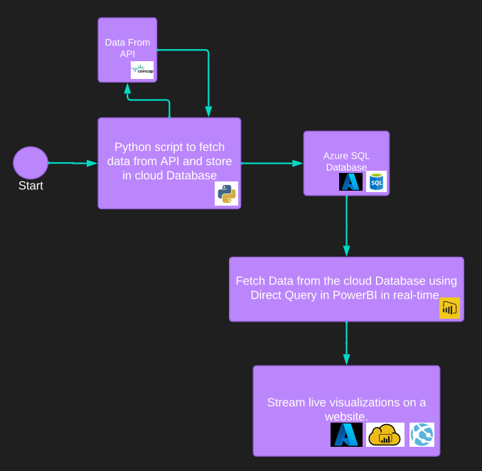
Project Architecture

Slide 6
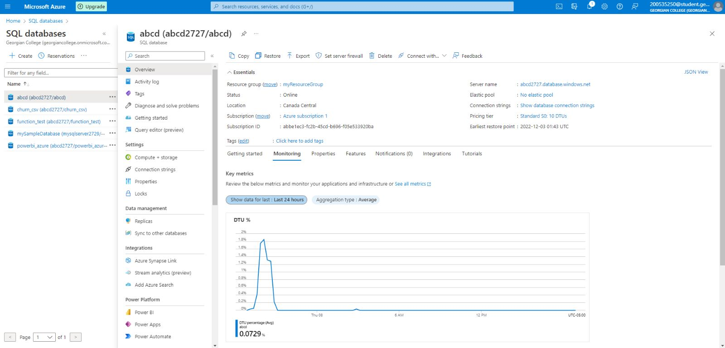
Azure SQL Database

Slide 7
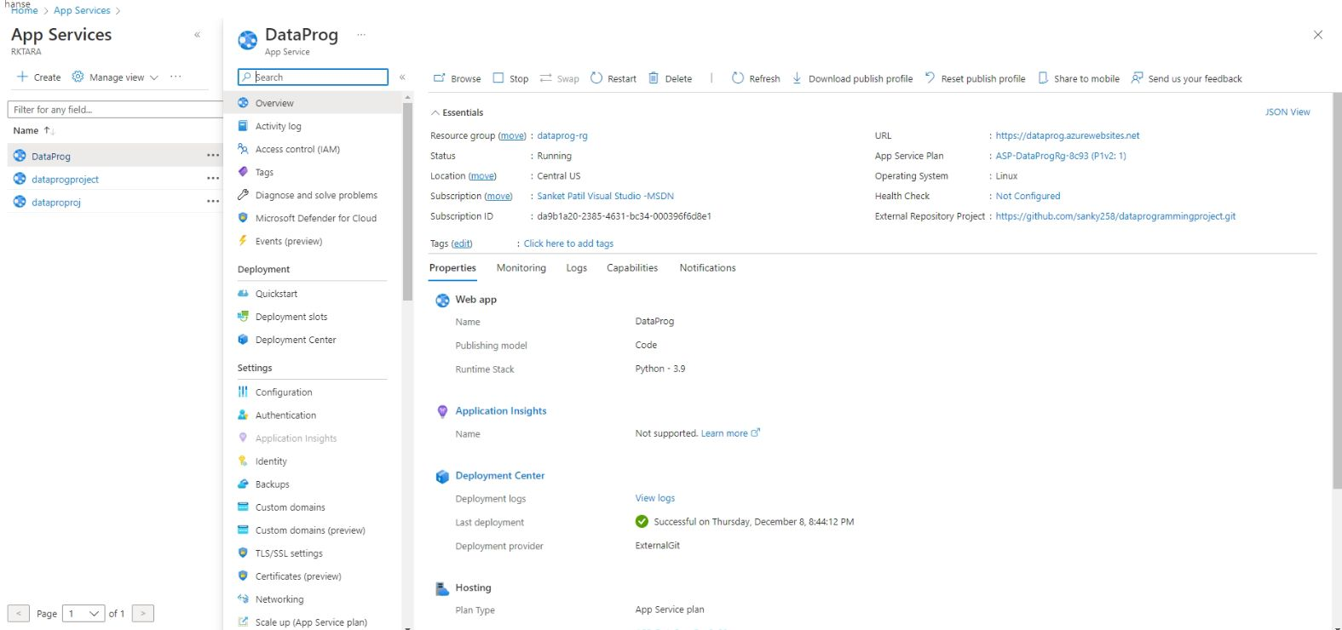
Azure App Service

Slide 8
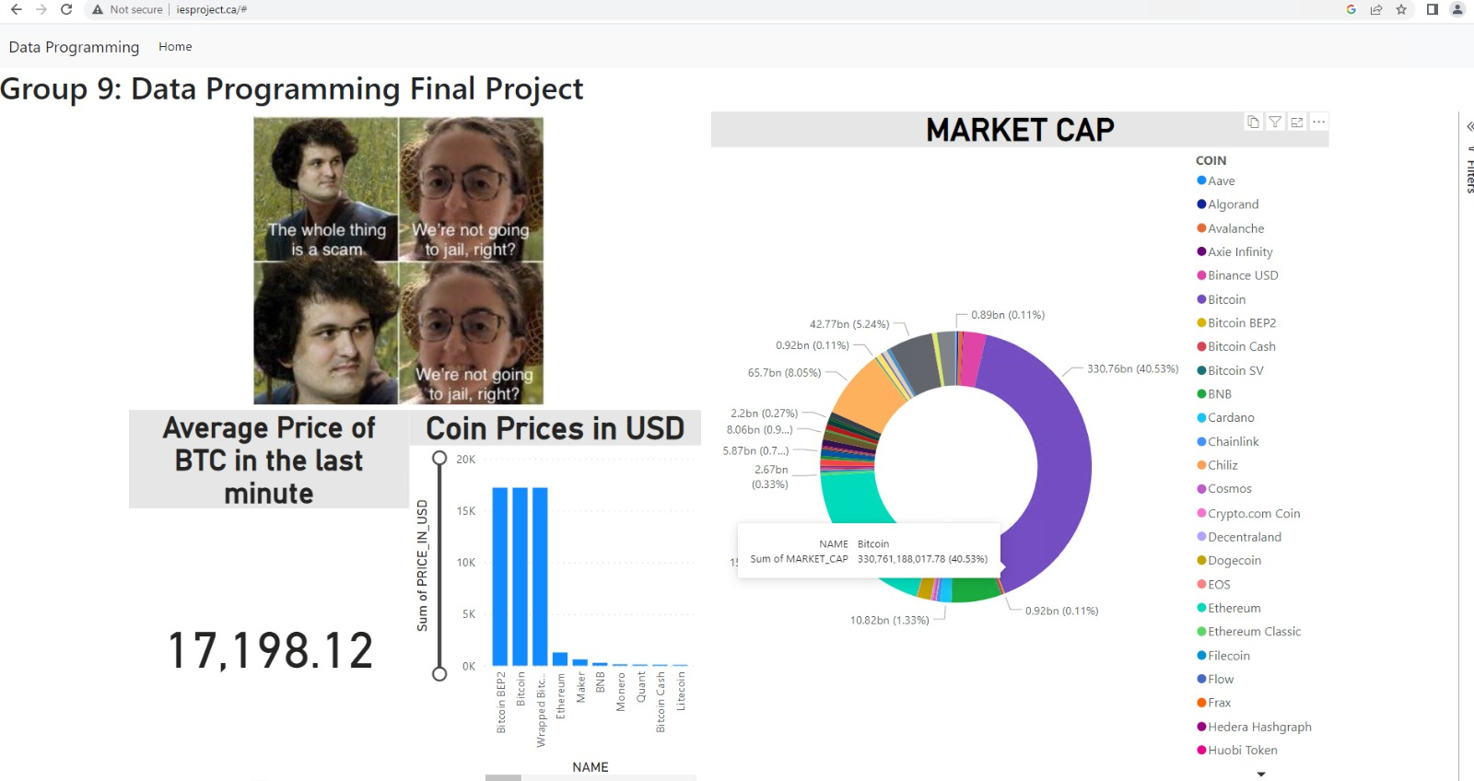
Web Application

Slide 9

Project Explanation

Slide 10
Thank You

